Slide 1
We will see
-1 what is a RDBMS
-show case most used RDBMS

Slide 2
What is a relational database management system ?
An RDBMS, or relational database management system, is the software that gives users the ability to update, query and administer a relational database. Structured Query Language (SQL) is typically the standard programming language used to access the database. To offer more flexibility, the SQL standard has been modified to enable storage, retrieval and publishing of JSON data within a relational database. Modern database management addresses the need for integrating, managing and analyzing data from multiple sources across on-premises and cloud environments. For example, the addition of the object relational model, which is similar to a relational database, has enabled vendors to offer extensions that support data types that are not part of the SQL standard, such as time-series data.

Slide 3
What is mysql ?
MySQL is a relational database management system (RDBMS) developed by Oracle that is based on structured query language (SQL).
A database is a structured collection of data. It may be anything from a simple shopping list to a picture gallery or a place to hold the vast amounts of information in a corporate network. In particular, a relational database is a digital store collecting data and organizing it according to the relational model. In this model, tables consist of rows and columns, and relationships between data elements all follow a strict logical structure. An RDBMS is simply the set of software tools used to actually implement, manage, and query such a database.
MySQL is integral to many of the most popular software stacks for building and maintaining everything from customer-facing web applications to powerful, data-driven B2B services. Its open-source nature, stability, and rich feature set, paired with ongoing development and support from Oracle, have meant that internet-critical organizations such as Facebook, Flickr, Twitter, Wikipedia, and YouTube all employ MySQL backends.

Slide 4
Partitioning
This feature improves the performance and provides fast management of the large database.
GUI Support
MySQL provides a unified visual database graphical user interface tool named "MySQL Workbench" to work with database architects, developers, and Database Administrators. MySQL Workbench provides SQL development, data modeling, data migration, and comprehensive administration tools for server configuration, user administration, backup, and many more. MySQL has a fully GUI supports from MySQL Server version 5.6 and higher.
Dual Password Support
MySQL version 8.0 provides support for dual passwords: one is the current password, and another is a secondary password, which allows us to transition to the new password

Slide 5
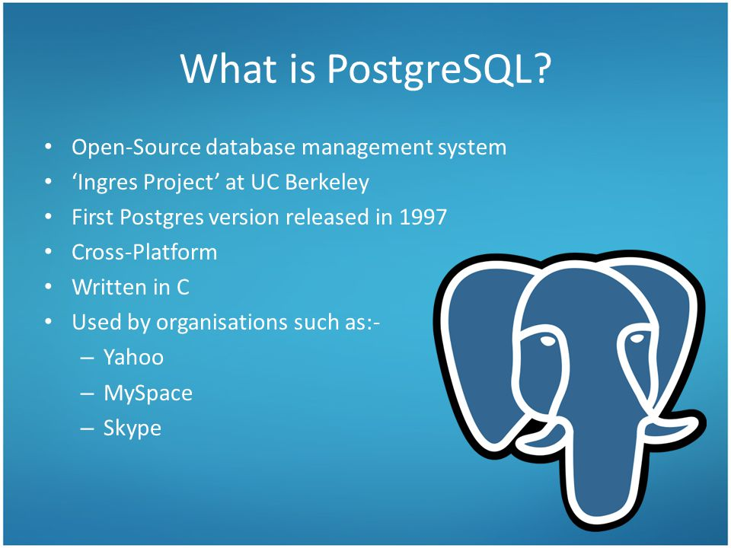

Slide 6
What is PostgreSQL
Let’s start with a simple question: what is PostgreSQL?
PostgreSQL is an advanced, enterprise-class, and open-source relational database system. PostgreSQL supports both SQL (relational) and JSON (non-relational) querying.
PostgreSQL is a highly stable database backed by more than 20 years of development by the open-source community.
PostgreSQL is used as a primary database for many web applications as well as mobile and analytics applications.

Slide 7
Futures
PostgreSQL has many advanced features that other enterprise-class database management systems offer, such as:
User-defined types
Table inheritance
Sophisticated locking mechanism
Foreign key referential integrity
Views, rules, subquery
Nested transactions (save points)
Multi-version concurrency control (MVCC)
Asynchronous replication
The recent versions of PostgreSQL support the following features:
Native Microsoft Windows Server version
Table spaces
Point-in-time recovery
And more new features are added in each new release.
PostgreSQL is designed to be extensible. PostgreSQL allows you to define your own data types, index types, functional languages, etc.
If you don’t like any part of the system, you can always develop a custom plugin to enhance it to meet your requirements e.g., adding a new optim

Slide 8
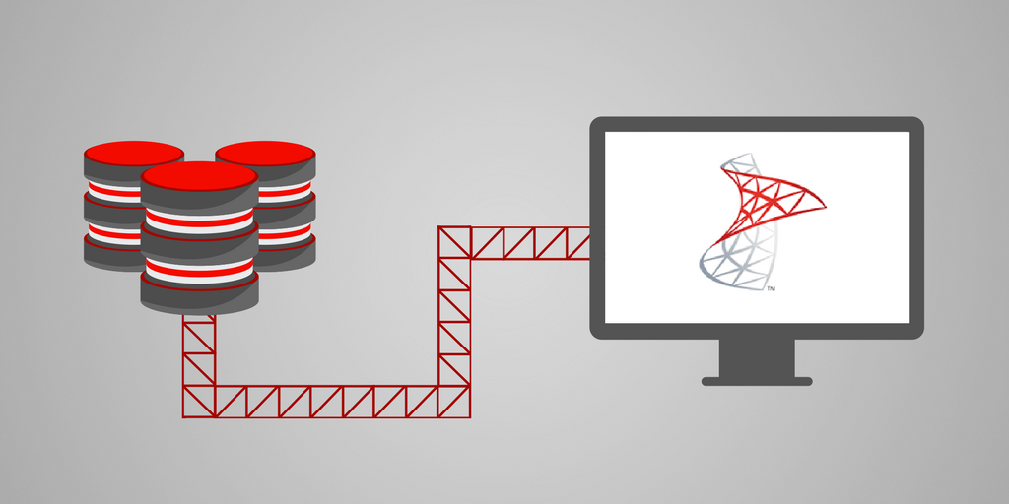
What is SQL server

Slide 9
SQL Server is a relational database management system, or RDBMS, developed and marketed by Microsoft.
Similar to other RDBMS software, SQL Server is built on top of SQL, a standard programming language for interacting with the relational databases. SQL server is tied to Transact-SQL, or T-SQL, the Microsoft’s implementation of SQL that adds a set of proprietary programming constructs.
SQL Server works exclusively on Windows environment for more than 20 years. In 2016, Microsoft made it available on Linux. SQL Server 2017 became generally available in October 2016 that ran on both Windows and Linux.

Slide 10
SQL sever editions
SQL Server Editions
Following are the popular editions/types of SQL server:
SQL Server Enterprise: It is used in the high end, large scale and mission Critical business. It provides High-end security, Advanced Analytics, Machine Learning, etc.
SQL Server Standard: Itis suitable for Mid-Tier Application and Data Marts. It includes basic reporting and analytics.
SQL Server WEB: It is designed for a low total-cost-of-ownership option for Web hosters. It provides scalability, affordability, and
manageability capabilities for small to large scale Web properties.
SQL Server Developer: It is similar to an enterprise edition for the non-production environment. It is mainly used for build, test, and demo.
SQL Server Express: It is for small scale applications and free to use.

Slide 11
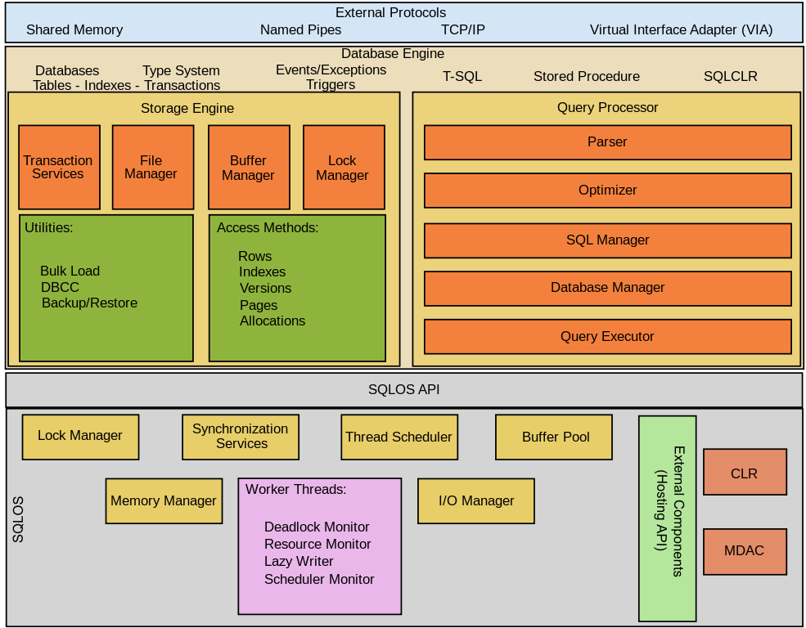
SQL server Architecture

Slide 12
SQL Server consists of two main components:
Database Engine
SQLOS
Database Engine
The core component of the SQL Server is the Database Engine. The Database Engine consists of a relational engine that processes queries and a storage engine that manages database files, pages, pages, index, etc. The database objects such as stored procedures, views, and triggers are also created and executed by the Database Engine.
Relational Engine
The Relational Engine contains the components that determine the best way to execute a query. The relational engine is also known as the query processor.
The relational engine requests data from the storage engine based on the input query and processed the results.
Some tasks of the relational engine include querying processing, memory management, thread and task management, buffer management, and distributed query processing.
Storage Engine
The storage engine is in charge of storage and retrieval of data from the storage systems such as disks and SAN.

Slide 13
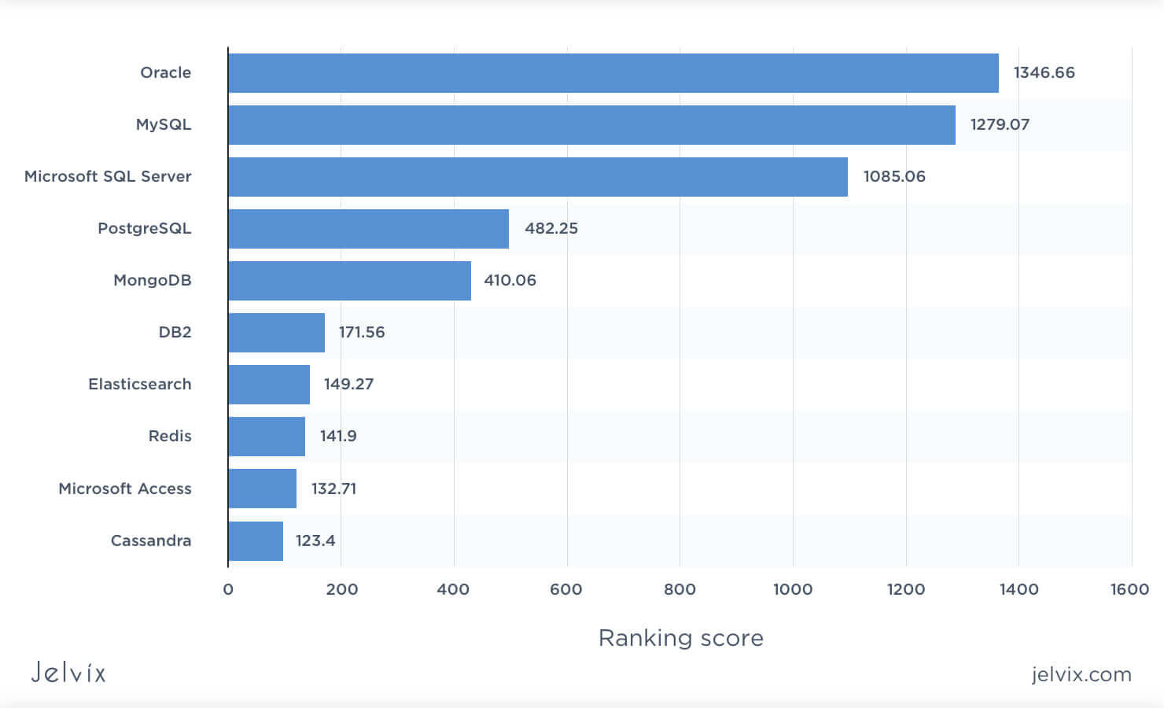
The differences between the previously mentioned RDBMSs
We’ll be taking a look at the three most popular relational databases: MySQL vs Postgresql vs SQL server.

